Slide 1

Dr. Helen Vijitha P
School of Computer Science and Engineering
VIT, Chennai

Slide 2
PPS 6-PROBLEM 1:
Let S = {a1, a2, ..., an} be the set of n proposed activities that uses the same resource (say, auditorium), which can serve only one activity at a time. Each activity has a start-time si and a finish-time fi , 0 ≤ si < ∞. Any two activities ai , aj are compatible if si ≥ fj or sj ≥ fi . The task is to select a maximum-size subset of mutually compatible activities from S.
1. Design a greedy algorithm for the activity selection problem by choosing the activity that starts last. Analyse the algorithm with the running time and the time complexity

Slide 3

PPS 6- 1 SOLUTION:
ILLUSTRATION
We have two activities:
$a_{i}=\left(s_{i} , f_{i}\right)$with start time $s_{i}$and finish time $f_{i}$.
$a_{j}=\left(s_{j} , f_{j}\right)$with start time $s_{j}$and finish time $f_{j}$.
They are compatible (i.e., can both be scheduled without overlap) if: $s_{i}≥f_{j} \text{or} s_{j}≥f_{i}$
si​≥fj​:
Activity $i$starts after or at the same time as activity $j$finishes. That means $i$comes completely after $j$.
$s_{j}≥f_{i}$:
Activity $j$starts after or at the same time as activity $i$finishes. That means $j$comes completely after $i$.
If either of these is true, then the two activities do not overlap in time → they are compatible.
Example:
$a_{1}=\left(1 , 4\right)$, $a_{2}=\left(4 , 6\right)$
  $s_{2}=4≥f_{1}=4$→ compatible.
$a_{1}=\left(1 , 5\right)$, $a_{2}=\left(3 , 7\right)$
  $s_{1}=1<7$, but $s_{2}=3<5$.Neither condition holds → they overlap → not compatible.

Slide 4

PPS 6- 1 SOLUTION:
Algorithm
Sort the activities in non-increasing order of start-time: $s_{1}≥s_{2}≥⋯≥s_{n}$.
Initialize selected = ∅ and last_start = +\infty.
Scan the sorted list from the largest start to the smallest:
  For each activity $a_{i}=\left(s_{i} , f_{i}\right)($in that order), if $f_{i}≤\text{last}\text{_}\text{start}$, then
    add $a_{i}$to selected
    set last_start = s_i.
Return selected.
(Why the condition $f_{i}≤\text{last}\text{_}\text{start}$? After you chose an activity with start last_start, any future activity you pick must finish no later than that start so they don't overlap.)

Slide 5
GREEDY-LATEST-START(S):
// S = list of activities (s_i, f_i)
sort S in non-increasing order of s_i // s1 >= s2 >= ... >= sn
selected = []
last_start = +infty
for each activity a in S (in this order):
if a.finish <= last_start:
selected.append(a)
last_start = a.start
return selected

Slide 6
Example :
Input activities (s,f):
(1,4), (3,5), (0,6), (5,7), (3,9),
(5,9), (6,10), (8,11), (8,12), (2,14), (12,16)
Sorted by start (descending):
(12,16), (8,11), (8,12), (6,10), (5,7), (5,9),
(3,5), (3,9), (2,14), (1,4), (0,6)
Pick (12,16) → last_start = 12
Pick (8,11) (11 ≤ 12) → last_start = 8
Skip (8,12) (12 ≤ 8 false)
Skip (6,10) (10 ≤ 8 false)
Pick (5,7) (7 ≤ 8) → last_start = 5
Skip (5,9)
Pick (3,5) (5 ≤ 5) → last_start = 3
rest are rejected
Selected set = (12,16), (8,11), (5,7), (3,5) — 4 activities, which is maximum

Slide 7
PPS 6-PROBLEM 2:
Suppose we have a set S of activities (with the start-time and the finish-time, as in the activity selection problem) that must be scheduled among many lecture halls, where any activity can take place in any lecture hall. The task is to schedule all the activities using as few lecture halls. We call this problem as ‘Extended activity selection problem’. Given the set of activities and the details of the lecture halls (say, l1, l2, ...lm), design a greedy algorithm to determine which activity should use which lecture hall. Analyse the algorithm with the running-time and the timecomplexity

Slide 8
PPS 6-PROBLEM 2:
Extended-Activity-Selection(S):
1. Sort all activities by increasing start time.
2. Create a min-heap (priority queue) to store halls by their finishing times.
Each entry: (finish_time, hall_id).
3. hall_count = 0
4. For each activity a in sorted S:
if heap is not empty AND heap.top.finish_time ≤ a.start:
Assign activity a to hall_id = heap.top.hall_id
Pop the top element from heap
Push (a.finish, hall_id) into heap
else:
hall_count += 1
Assign activity a to hall_id = hall_count
Push (a.finish, hall_count) into heap
5. Return hall assignments and hall_count

Slide 9
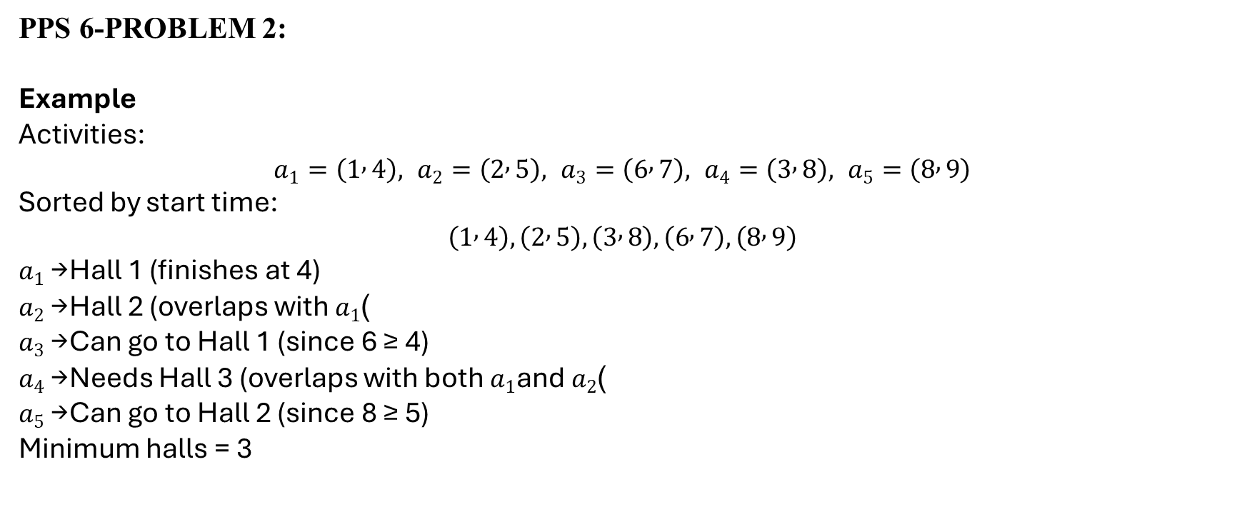
PPS 6-PROBLEM 2:
Example
Activities:
$$a_{1}=\left(1 , 4\right), a_{2}=\left(2 , 5\right), a_{3}=\left(6 , 7\right), a_{4}=\left(3 , 8\right), a_{5}=\left(8 , 9\right)$$
Sorted by start time:
$$\left(1 , 4\right),\left(2 , 5\right),\left(3 , 8\right),\left(6 , 7\right),\left(8 , 9\right)$$
$a_{1}$→ Hall 1 (finishes at 4)
$a_{2}$→ Hall 2 (overlaps with $a_{1}$)
$a_{3}$→ Can go to Hall 1 (since 6 ≥ 4)
$a_{4}$→ Needs Hall 3 (overlaps with both $a_{1}$and $a_{2}$)
$a_{5}$→ Can go to Hall 2 (since 8 ≥ 5)
Minimum halls = 3

Slide 10
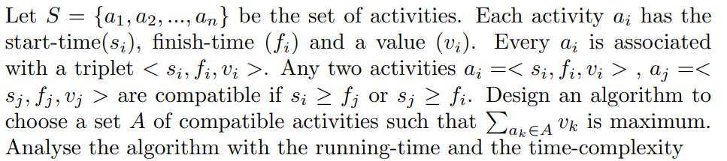
PPS 6-PROBLEM 3:

Slide 11
Example :
Input activities (s,f):
(1,4), (3,5), (0,6), (5,7), (3,9),
(5,9), (6,10), (8,11), (8,12), (2,14), (12,16)
Sorted by start (descending):
(12,16), (8,11), (8,12), (6,10), (5,7), (5,9),
(3,5), (3,9), (2,14), (1,4), (0,6)
Pick (12,16) → last_start = 12
Pick (8,11) (11 ≤ 12) → last_start = 8
Skip (8,12) (12 ≤ 8 false)
Skip (6,10) (10 ≤ 8 false)
Pick (5,7) (7 ≤ 8) → last_start = 5
Skip (5,9)
Pick (3,5) (5 ≤ 5) → last_start = 3
rest are rejected
Selected set = (12,16), (8,11), (5,7), (3,5) — 4 activities, which is maximum

Slide 12
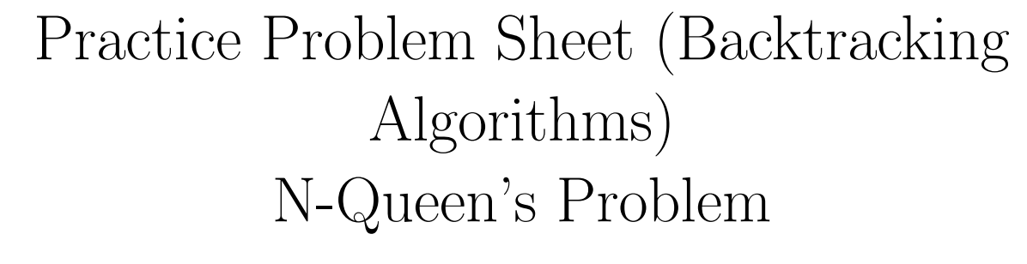
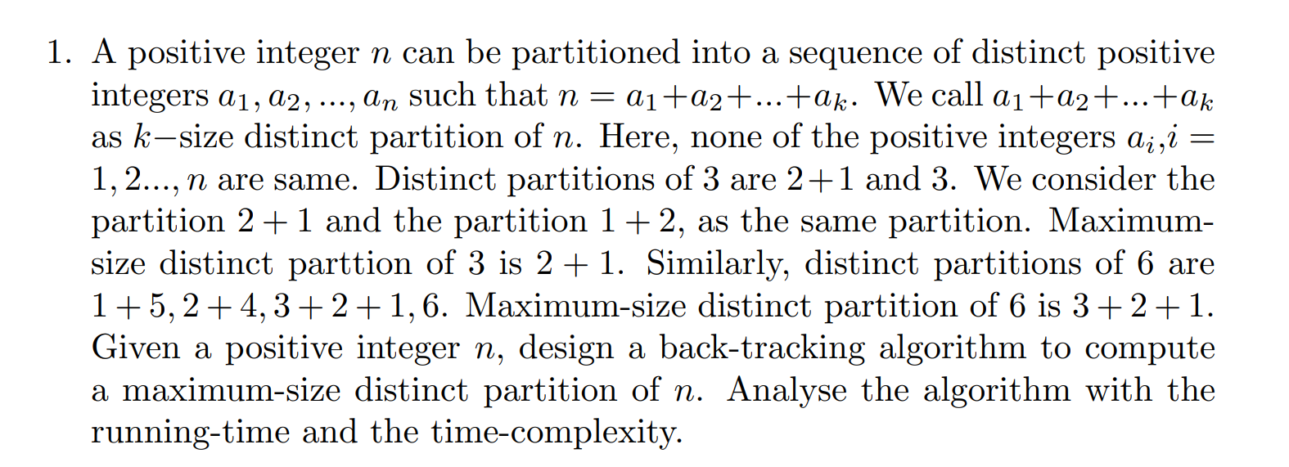

Slide 13
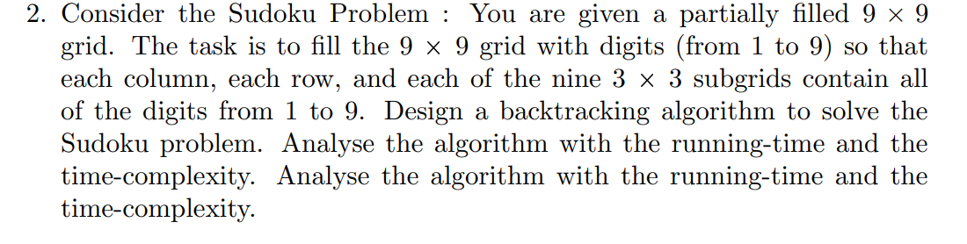

Slide 14
function SolveSudoku(board):
if there is no empty cell:
return True // Sudoku solved
(row, col) = next empty cell
for num in 1 to 9:
if isSafe(board, row, col, num):
board[row][col] = num // place number
if SolveSudoku(board):
return True // solved recursively
board[row][col] = 0 // backtrack
return False
function isSafe(board, row, col, num):
// Check row
if num in board[row]:
return False
// Check column
if num in board[i][col] for i in 0..8:
return False
// Check 3x3 subgrid
startRow = row - row % 3
startCol = col - col % 3
for i in 0..2:
for j in 0..2:
if board[startRow + i][startCol + j] == num:
return False
return True

Slide 15
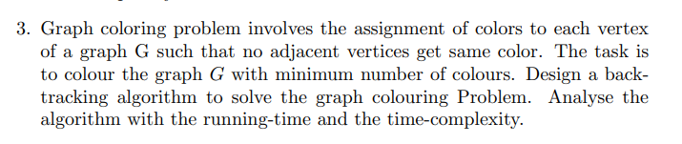

Slide 16
function graphColoring(G, m):
# G: graph, m: number of colors available
color[] = array of size |V| initialized to 0
if solveColoring(G, m, color, 0) == true:
return color
else:
return "No solution"
function solveColoring(G, m, color, v):
if v == |V|:
return true # all vertices colored
for c in 1 to m:
if isSafe(G, v, color, c):
color[v] = c
if solveColoring(G, m, color, v+1):
return true
color[v] = 0 # backtrack
return false
function isSafe(G, v, color, c):
for each u in Adj[v]:
if color[u] == c:
return false
return true

Slide 17
Problem: Given a string S of length n (distinct symbols assumed), output all permutations of its symbols in alphabetical order.
Example: S = "abc" → abc, acb, bac, bca, cab, cba.

Slide 18
BACKTRACKING:
# Input: string S of length n
# Precondition: sort S to ensure alphabetical enumeration
function permute_backtrack(prefix, used[]):
if length(prefix) == n:
output prefix
return
for i from 0 to n-1: # iterate characters in sorted order
if not used[i]:
used[i] = true
permute_backtrack(prefix + S[i], used)
used[i] = false # backtrack
# call:
sort S's characters
used = array[n] of false
permute_backtrack("", used)
BRUTE FORCE:
# Input: array A[0..n-1] containing the characters of S (already sorted if you want lexicographic output)
function permute_swap(A, l, r): # l = current
index, r = n-1
if l == r:
output A as one permutation
return
for i from l to r:
swap(A[l], A[i])
permute_swap(A, l+1, r)
swap(A[l], A[i]) # backtrack

Slide 19
THANK YOU

